Slide 1


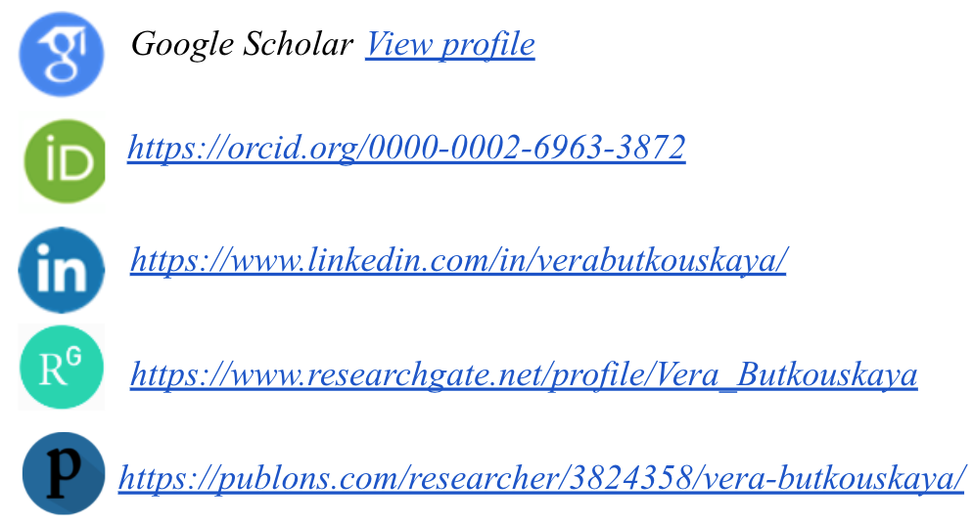
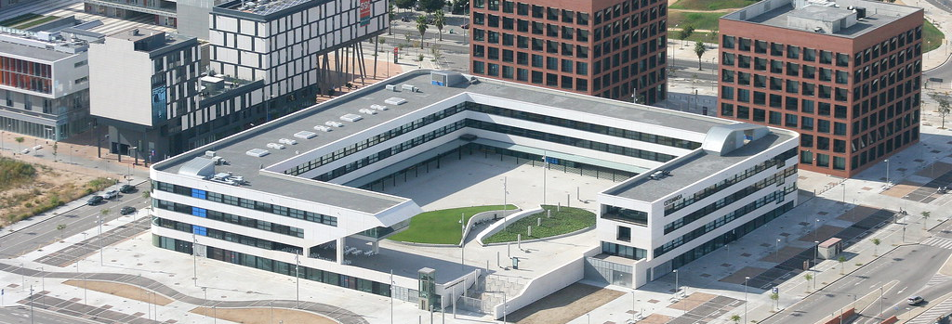
Defensa de plaza
Vera Butkouskaya, PhD
✉ vera.butkouskaya@gmail.com
VeraPetrovna.com
February, 2022

Slide 2
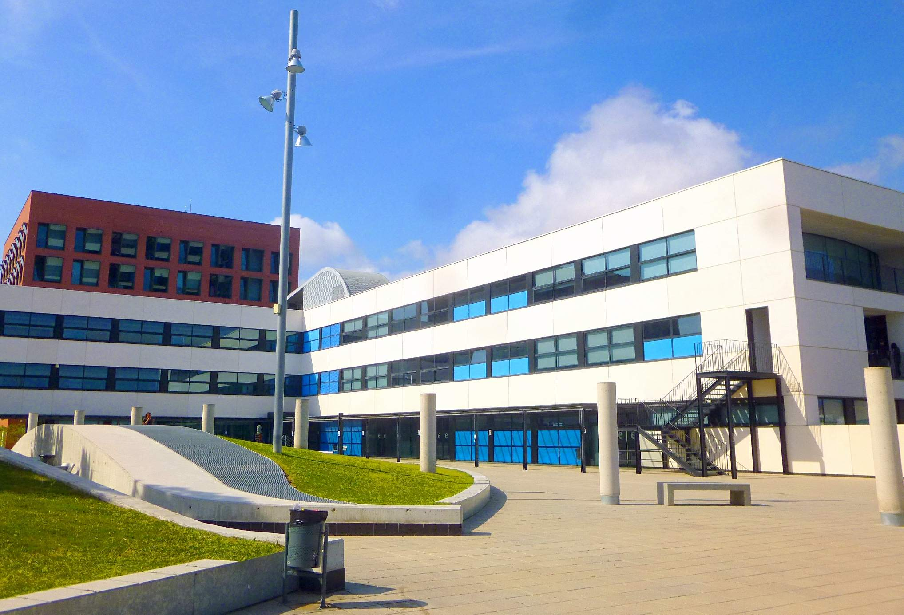
Content
Profile:
  Education
  Professional Experience
  Teaching Experience
  Research Experience
Course Presentation
  Justification
  Objectives
  Methodology
  Learning Outcomes
Personal Profile

Slide 3
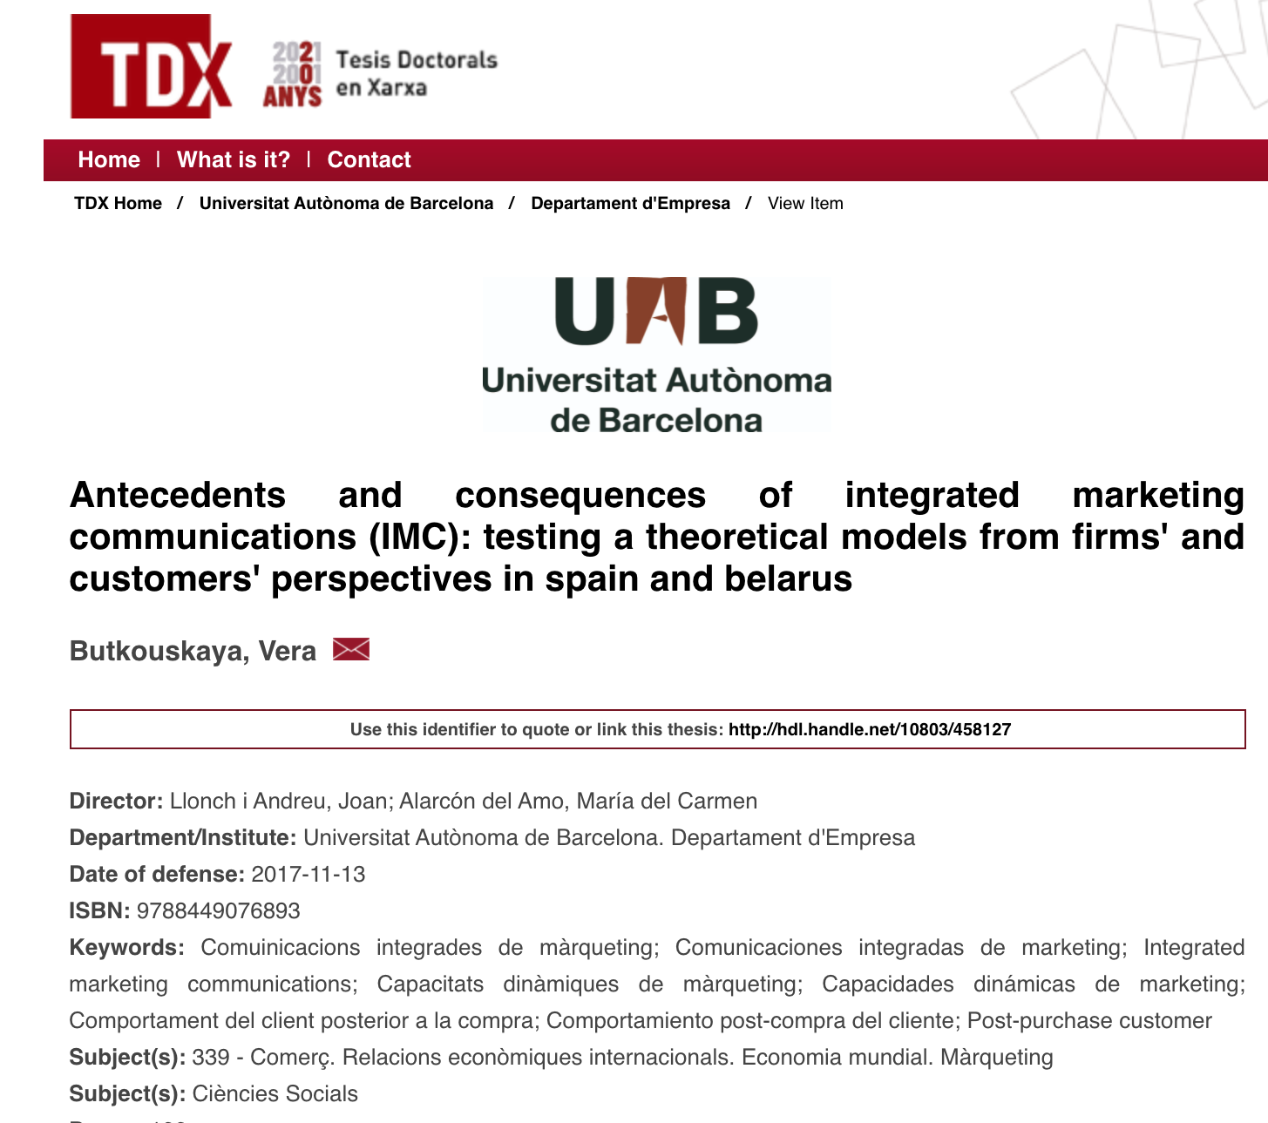
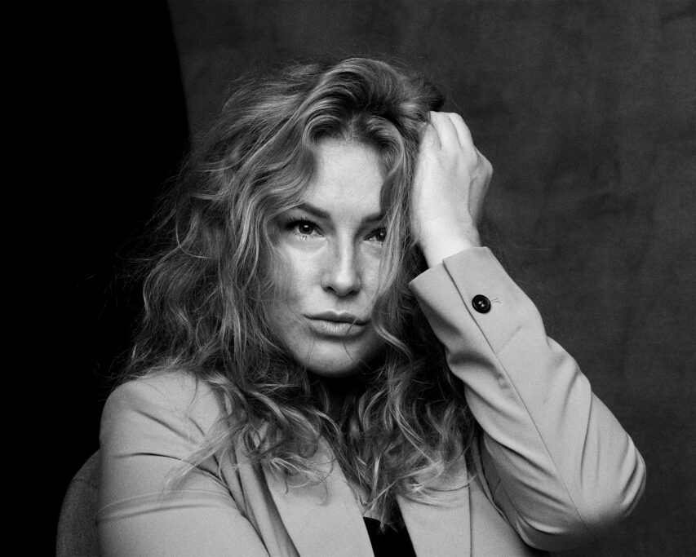
Dr. Vera Butkouskaya
Origin:
Minsk, Belarus
Current location:
Barcelona, Spain
Education:
BA in Engineering and Economy
MSc in Economy and Marketing / Belarusian National Technical University (BNTU), Minsk, Belarus
International Ph.D. in Entrepreneurship and Management / Autonomous University of Barcelona (UAB), Spain.
International Mention, Cum Laude
Tecnocampus, Mataro | February, 2022

Slide 4


Professional Experience / Career
Since 2008 from
economist, sales and marketing specialist:
  Economics and Pricing, Sales Management and Communications, Team Leadership and Project management
through
Marketing Director and Entrepreneur:
  Marketing and Strategic Management
to
Business Consultant in Digital Transformation in cross-cultural markets
Industry experience: E-commerce, Tourism and Hospitality, Restaurants, Engineering, Retail, Medicine, Beauty and Fashion, Furniture, Construction, and others
from Multi-tasking to Specialisation
Tecnocampus, Mataro | February, 2022

Slide 5


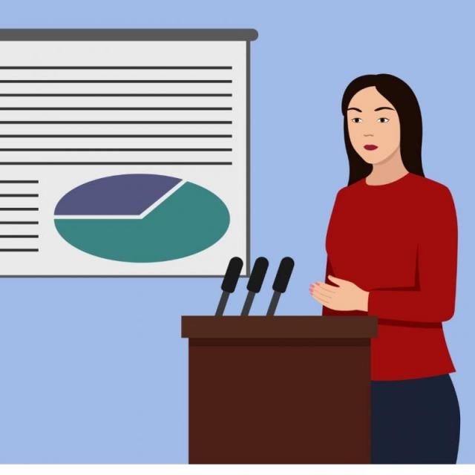




Teaching Experience / Interests / Highlights
Teaching Experience – since 2010:
Various Business Administration subjects:
  Marketing (Basics, International, Strategic, Digital, Communications), Human Resources Management, Strategic Management, Cost Management, Web Analytics
Interests:
Digital Marketing, Communications, Entrepreneurship
Highlights:
Teaching, Coaching, Tutoriation, Exchange and Innovation
  academic and practical courses (College, Bachelor, Master and Professionals)
  Course Planning, Development
  International Exchange classes
  Innovative teaching and communication methods
  Teaching on distance, online, hybrid classes
  Coaching on critical thinking and soft skills
  Tutoring Final Thesis (Undergraduate, Master and Doctoral students)
from basic knowledge to Interdisciplinary concept
Teaching in English, Spanish, Russian
In Belarus, Russia, Spain, Finland
Teaching Philosophy – Customization
Tecnocampus, Mataro | February, 2022

Slide 6
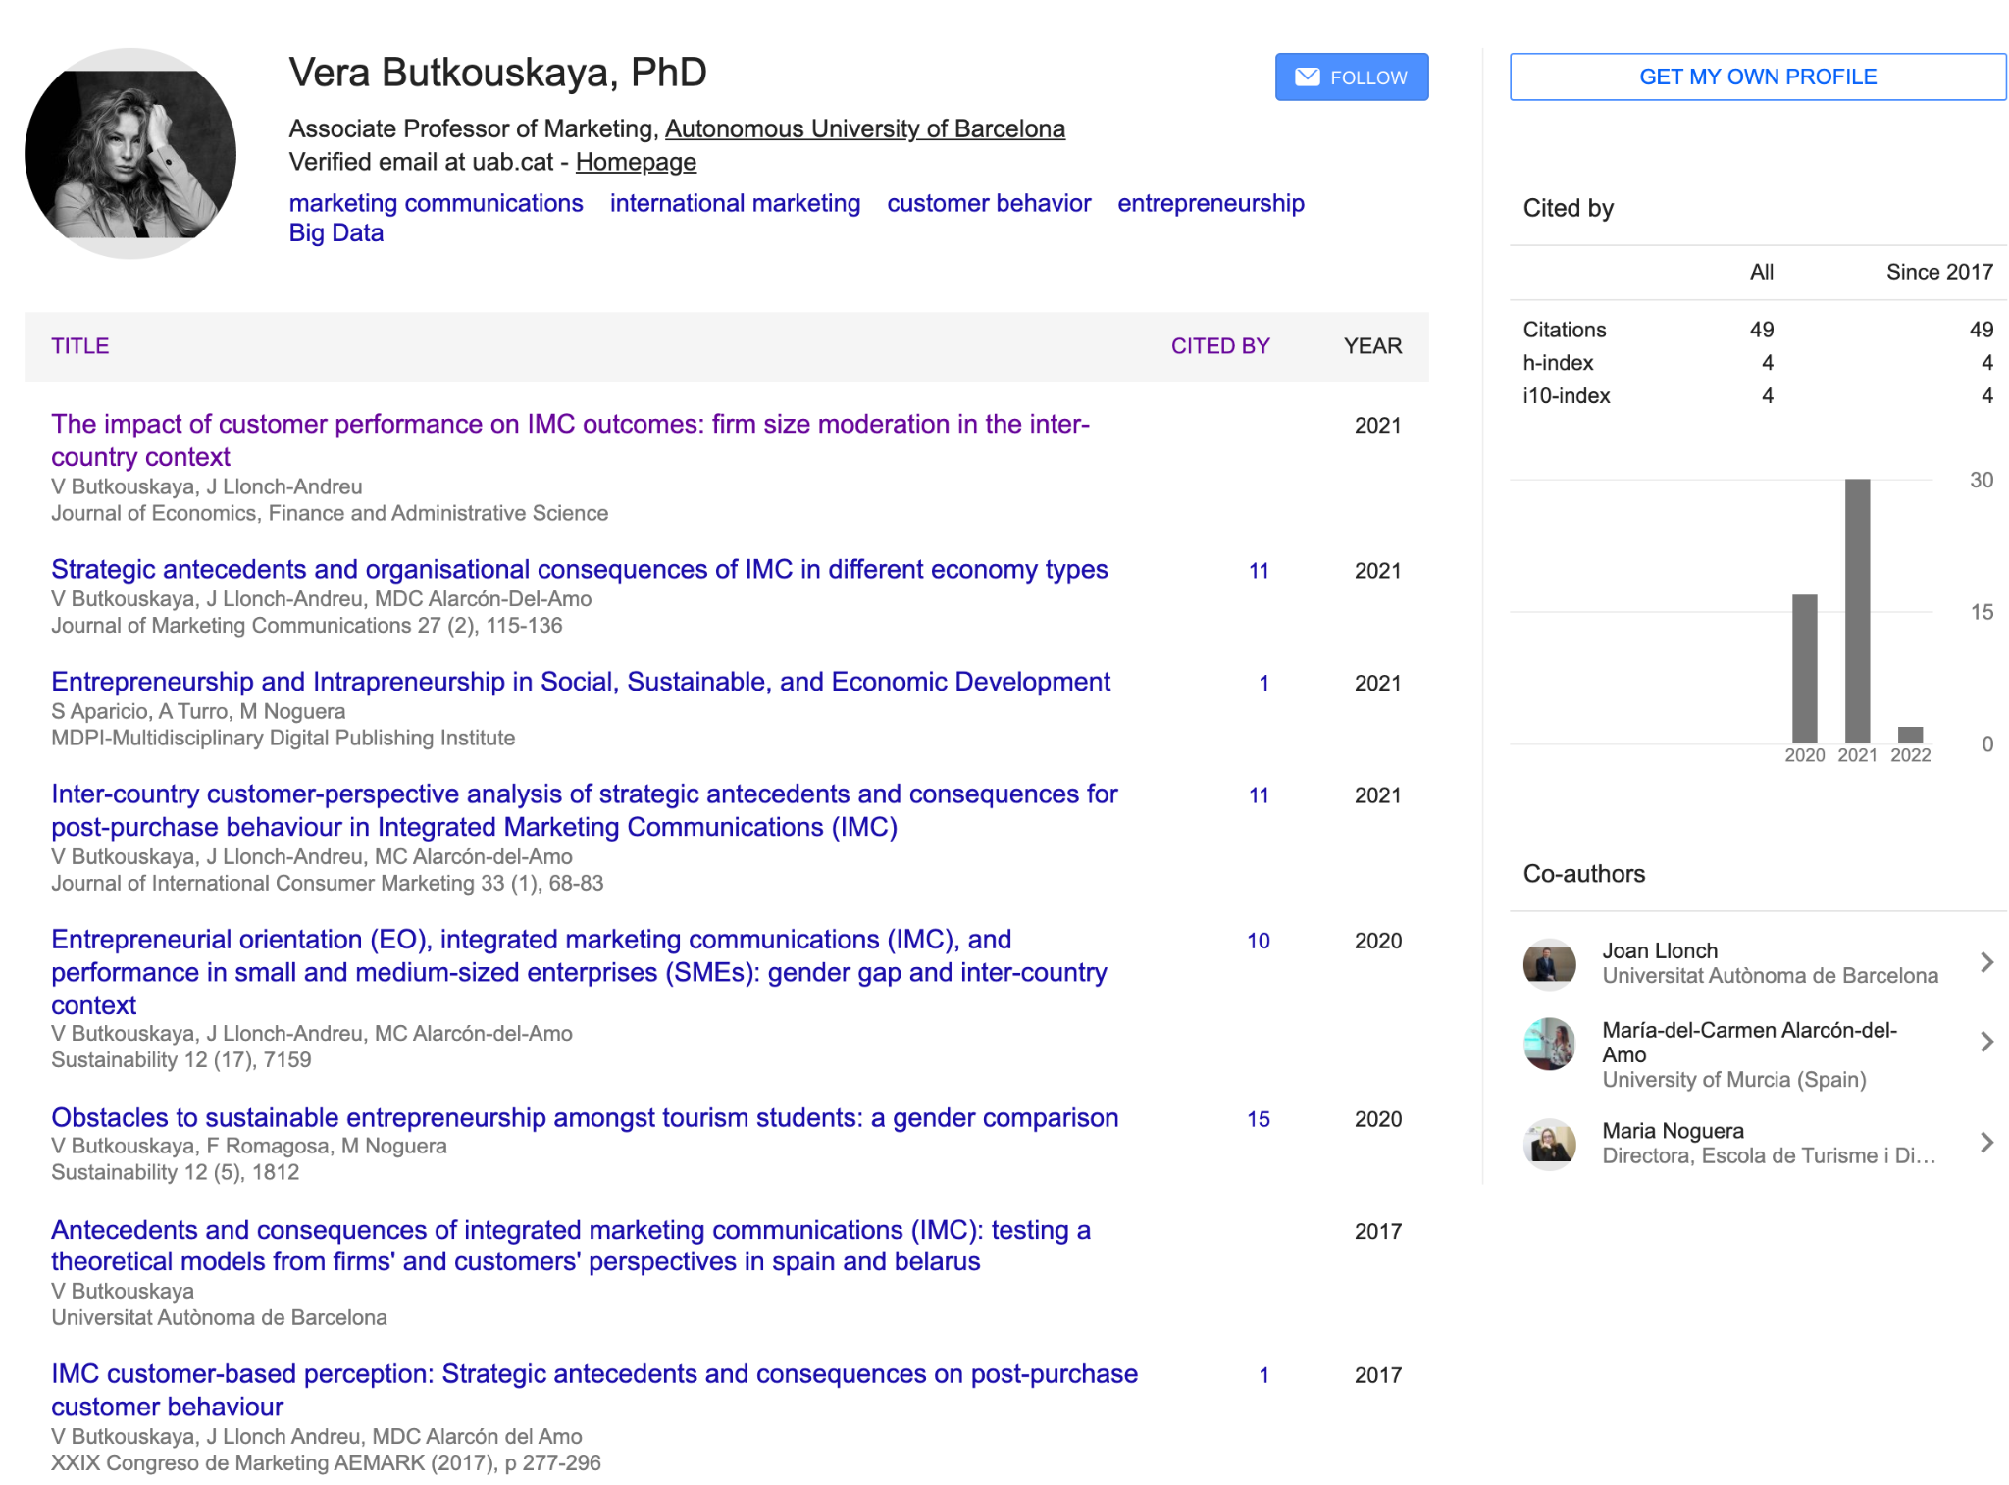
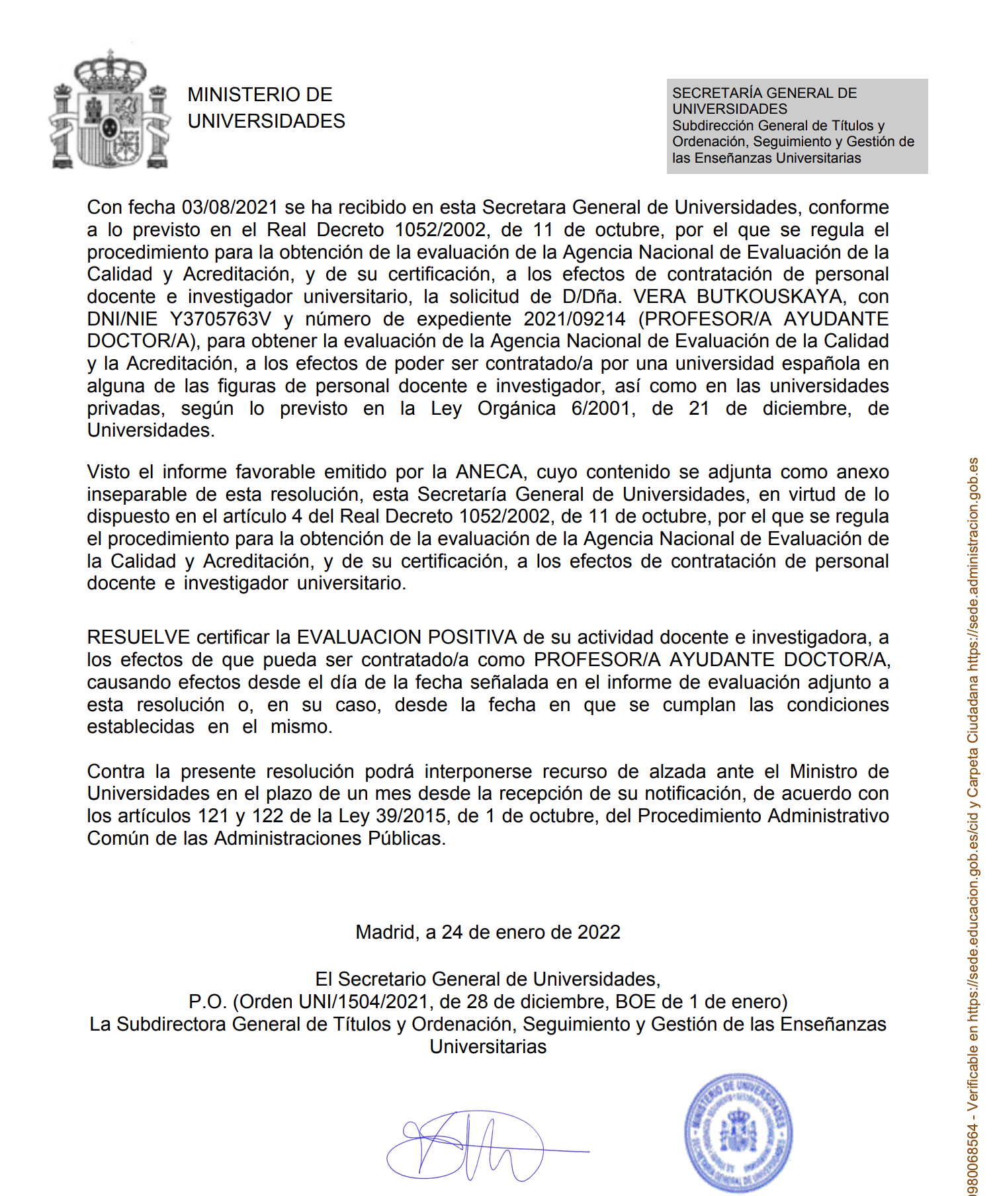
Research Experience / Publications
Research Experience – since 2008:
Research:
  1 research work during Bachelor degree
  1 research work during Master degree
  prices in the national competition
Grands and scholarships:
  Scholarship BNTU, Minsk, Belarus
  PhD Grand UAB, Barcelona, Spain
  Research Grand HSE, Moscow, Russia
Publications:
  JSR, Scopus, Peer-review, International Journals
  Research in Progress
Participation in Conferences:
  Marketing and Management
  Recent accepted to 2022 AMS Annual Conference, Monterey, CA
Acreditacion ANECA:
  Ayudante Doctor, february 2022
Reviewing for Journals
Research is a life-style
Tecnocampus, Mataro | February, 2022

Slide 7







Course Presentation
Trends:
  Digitalization
  Digital disruption
  Covid-19
  Transformation of existing business models
  Ecosystem competitive advantage
  Customer Community
Fast industry changes and
  Slow theoretical updates
Tecnocampus, Mataro | February, 2022

Slide 8
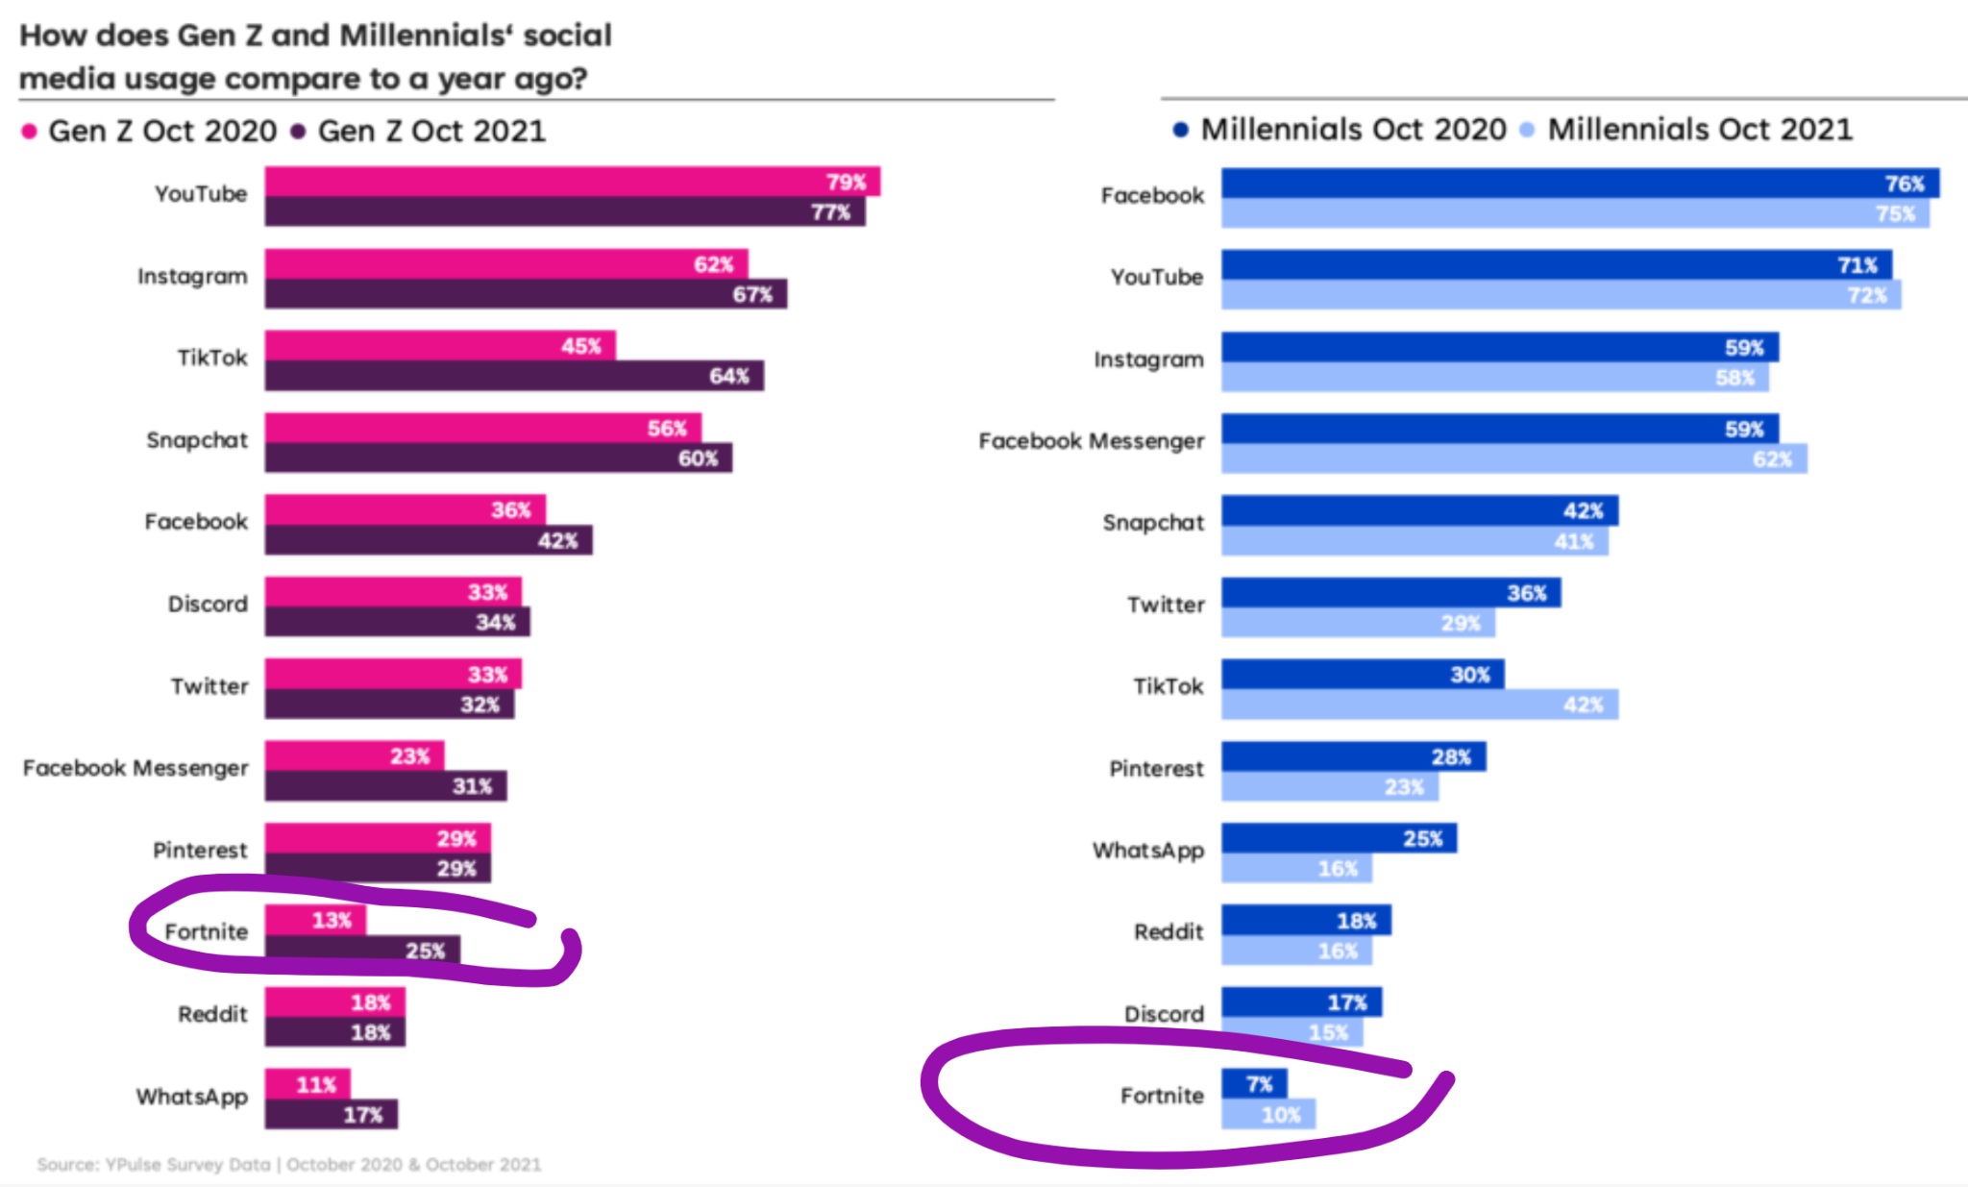
Course “Digital Marketing Communications”
Justification:
  New technologies and digital media - a part of daily life
    More with the impact of COVID-19
  Companies are changing communication strategies:
    From website and digital ads to social media, content and community
    From Multichannel to Omnichannel marketing
  Increase in communication intensity
    From inbound to outbound marketing
    From Communication to Community
Currently Teaching at Tecnocampus:
Interpersonal Relationships,
WebAnalytics, Digital Communications
Tecnocampus, Mataro | February, 2022

Slide 9


Course “Digital Communications”
Objective: to understand the current state of the art in digital marketing communications and to implement knowledge into real life practice:
  How can the company communicate in a way that the message will be perceived correctly by the receiver?
  How can interactive digital communication strategy be built
    To attract attention
    Impact reputation
    Motivate for purchase
    Improve satisfaction and
    Retain customers?
  How can the company use the feedback provided through two-way Communications with the customer to improve organizational performance?
Tecnocampus, Mataro | February, 2022

Slide 10
Course “Digital Communications”
Course content:
Tema 1: From Traditional Communication to the New Digital Ecosystem
Tema 2: Integrated marketing communications (IMC) across multiple digital channels
Tema 3: Creating an interactive dialog with the customers through digital media
Tema 4: Customer Big data as a source of company's processes optimization
Tema 5: Measuring the IMC positive effect on company's performance
Tecnocampus, Mataro | February, 2022

Slide 11
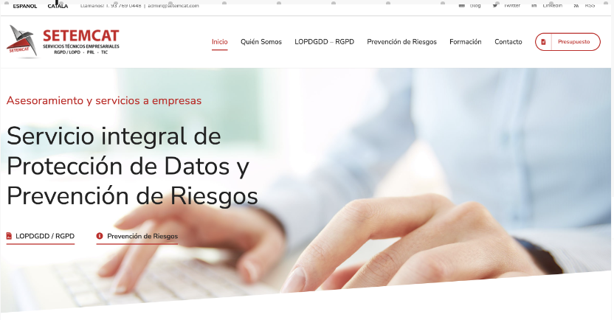
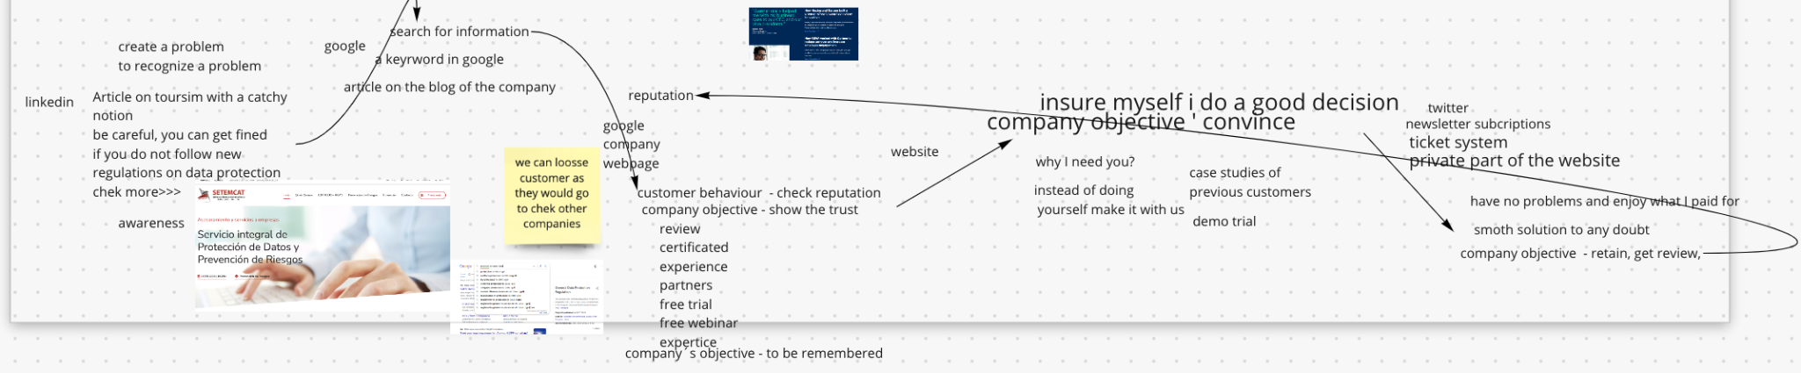
Course “Digital Communications”
Methodology:
Practical Cases
  Prepared by professor
  Suggested by students
Team Project
Additional Materials
Final Exam
Tecnocampus, Mataro | February, 2022

Slide 12
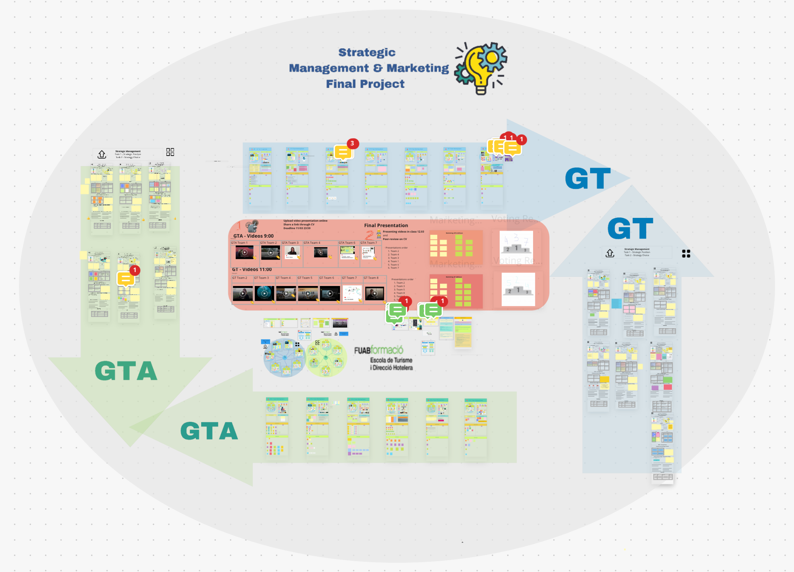

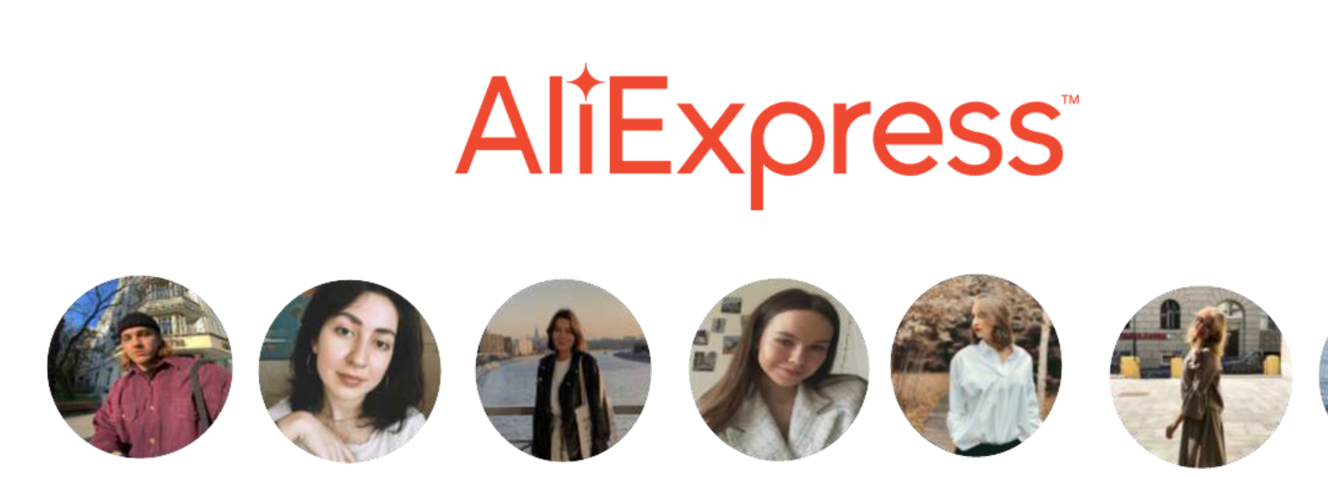
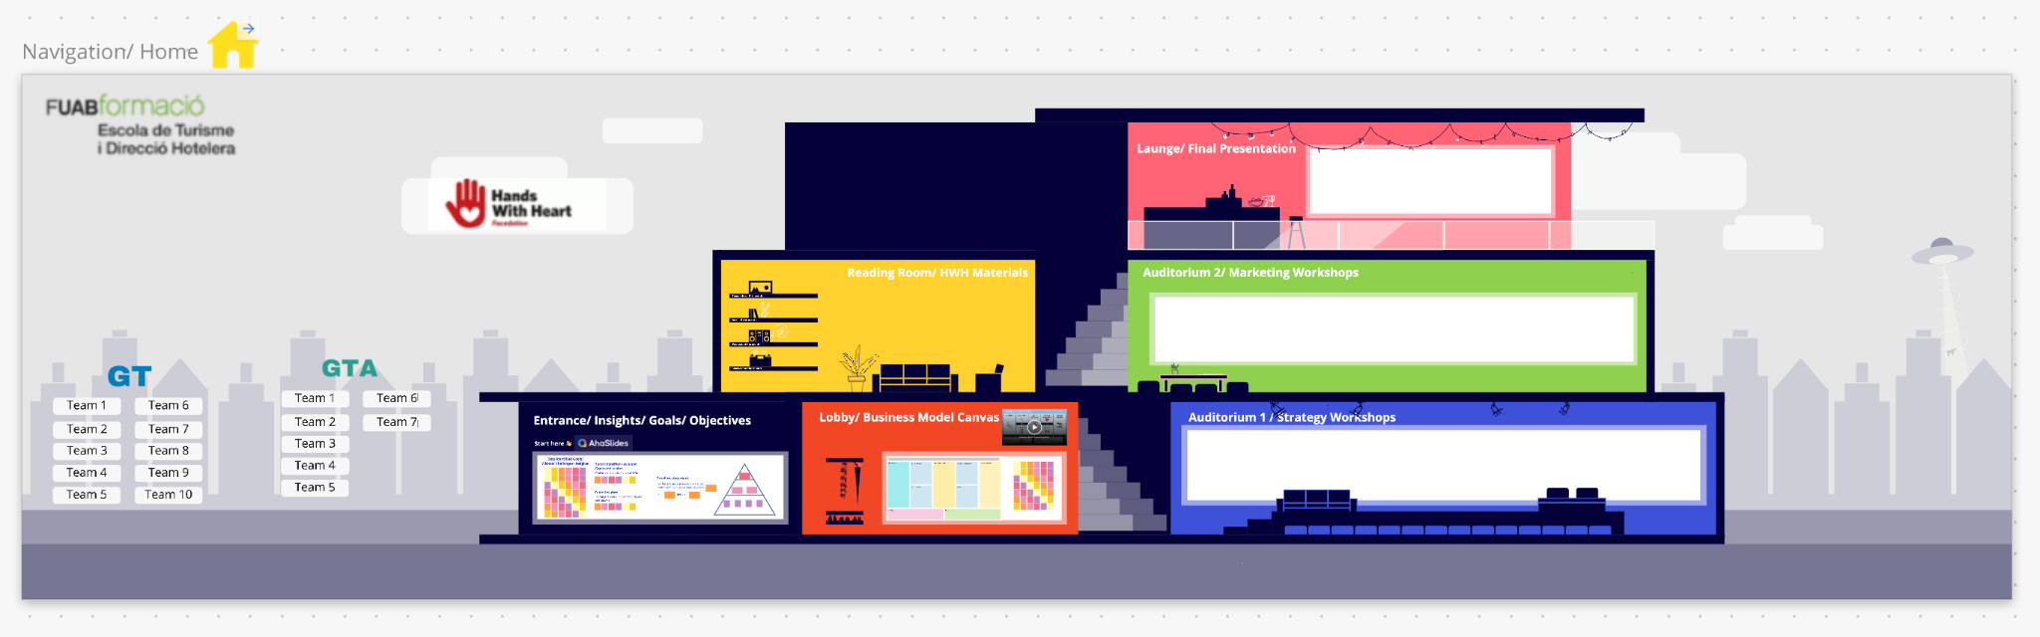
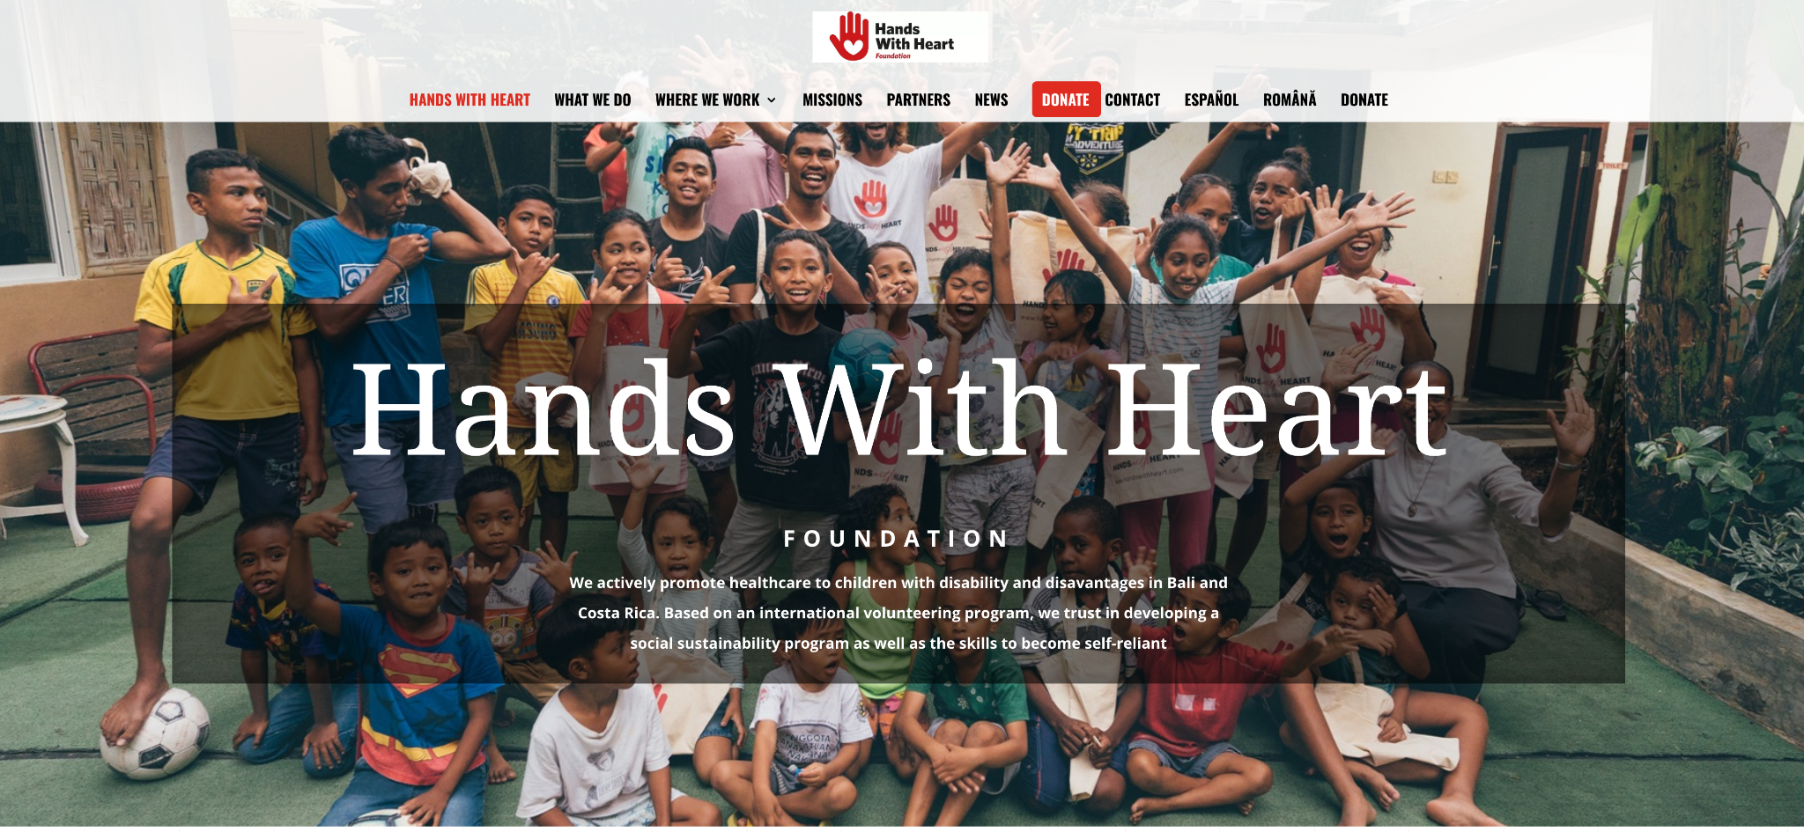
Course Presentation
Year 1
Year 2
Year 2
Tecnocampus, Mataro | February, 2022

Slide 13

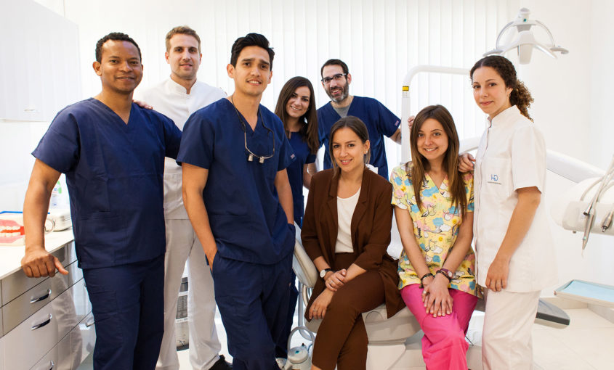
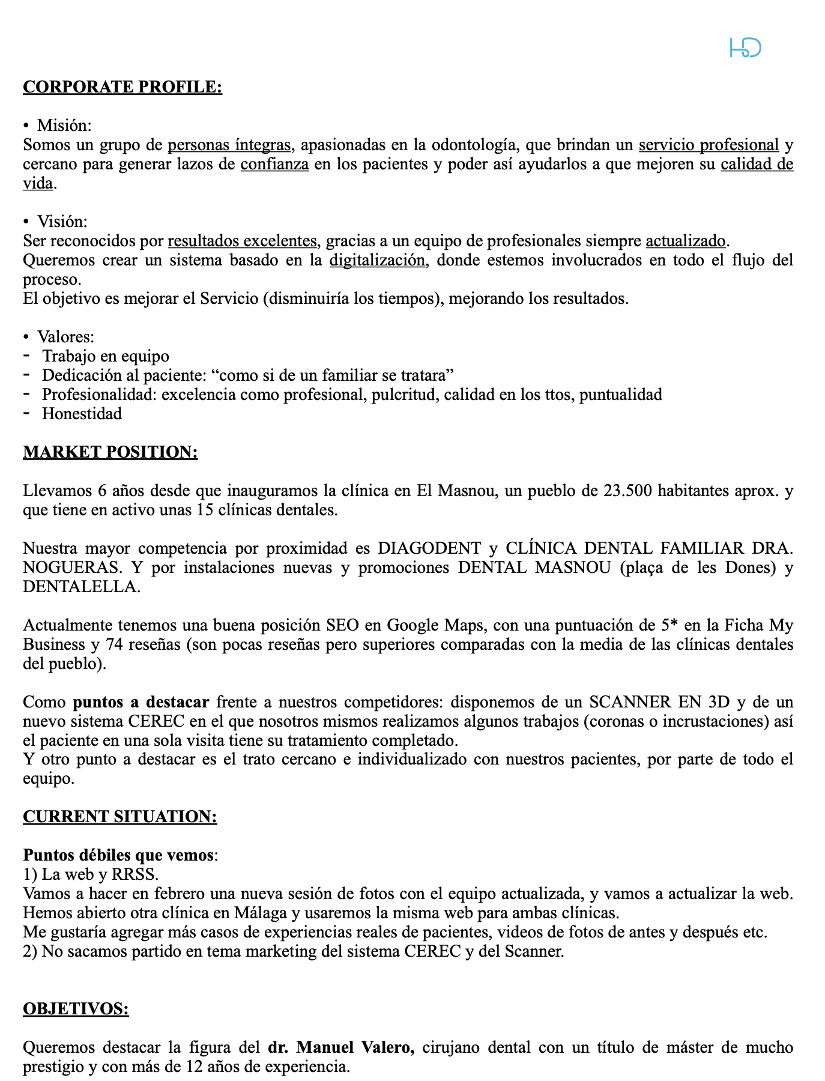
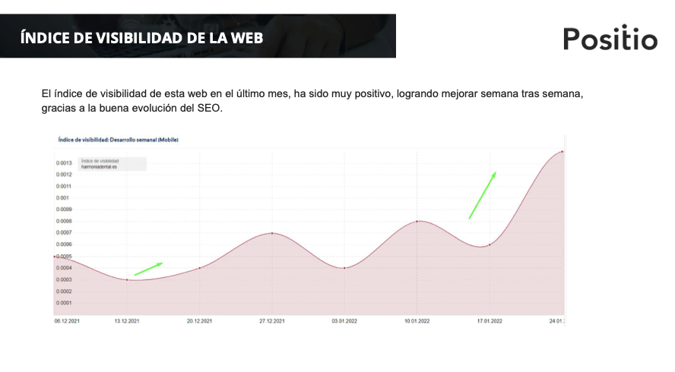
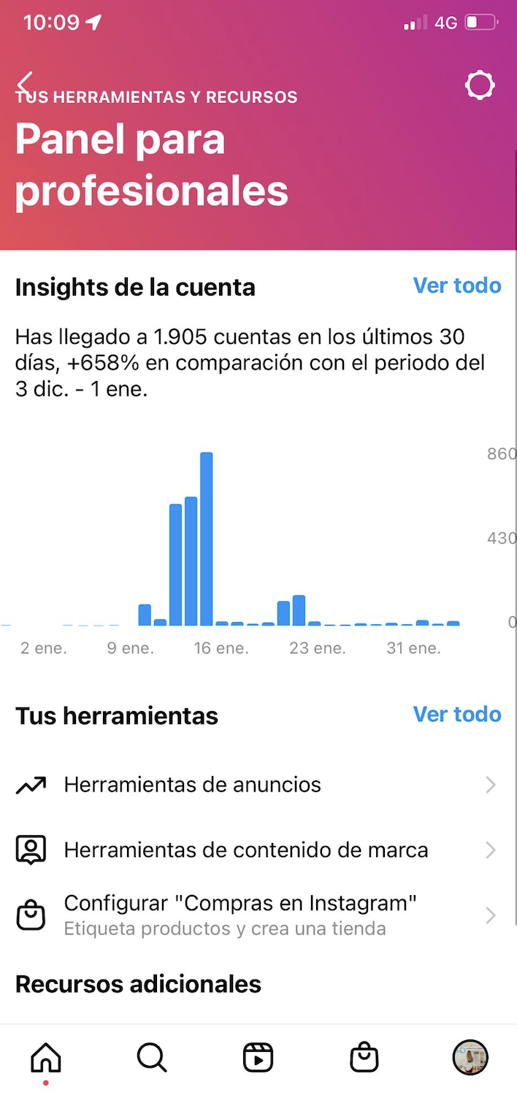
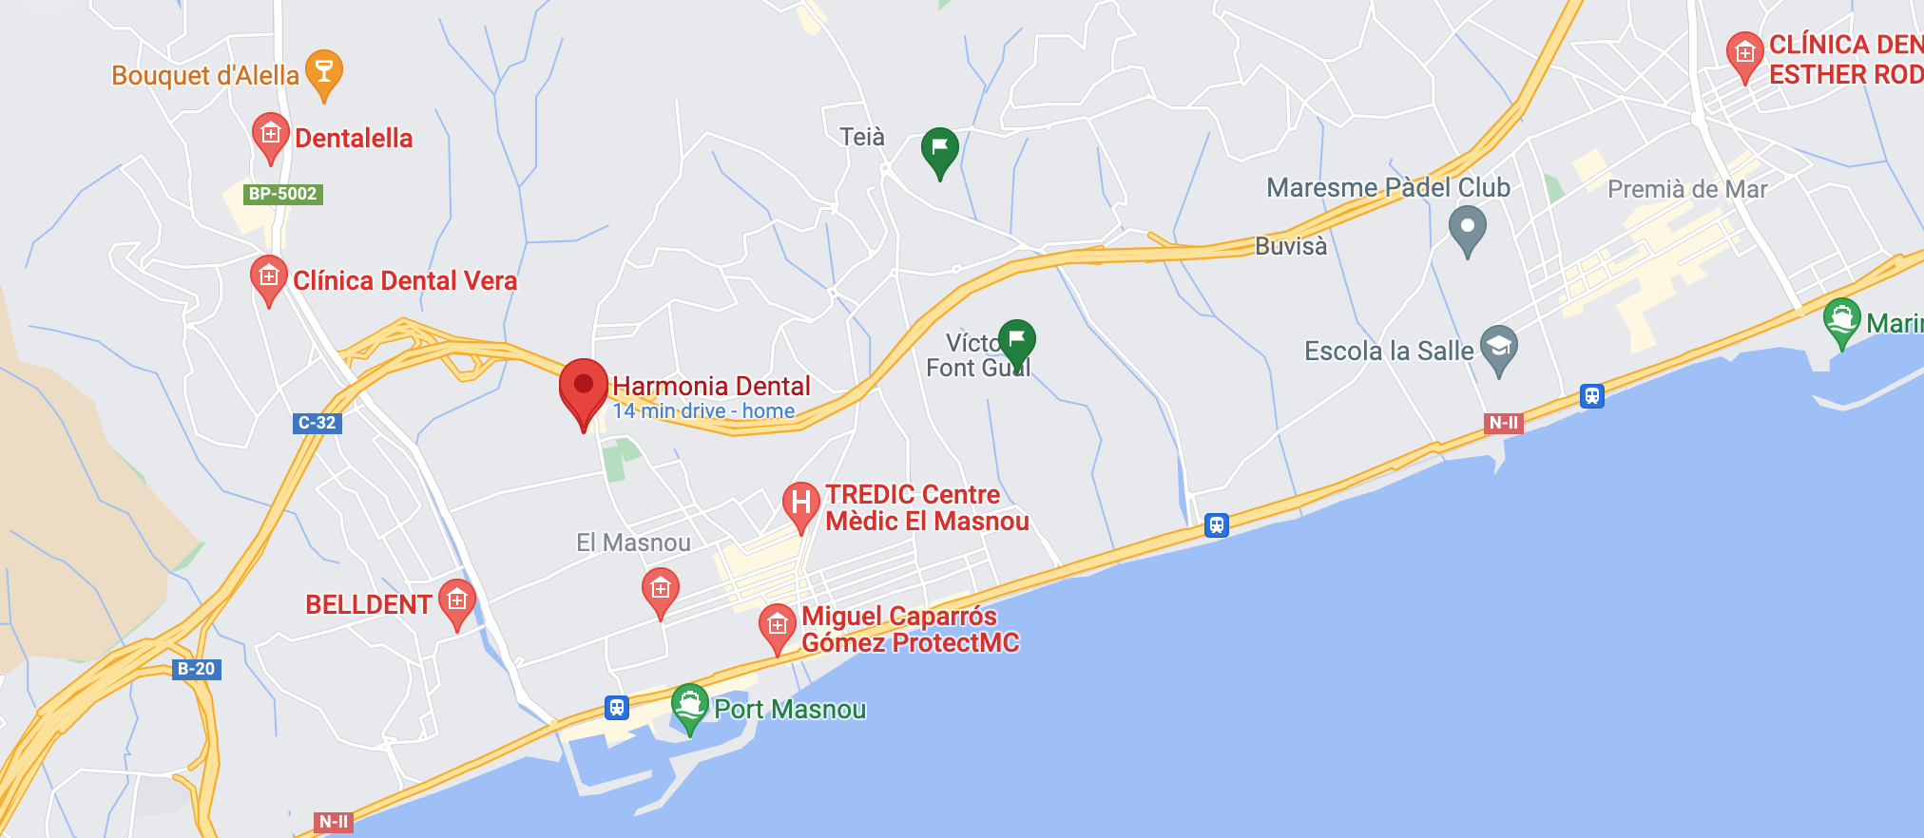

Course “Digital Communications”
Methodology:
Practical Cases
Team Project
  based on the real company Brief
Additional Materials
Final Exam
Sustainable development
Tecnocampus, Mataro | February, 2022

Slide 14
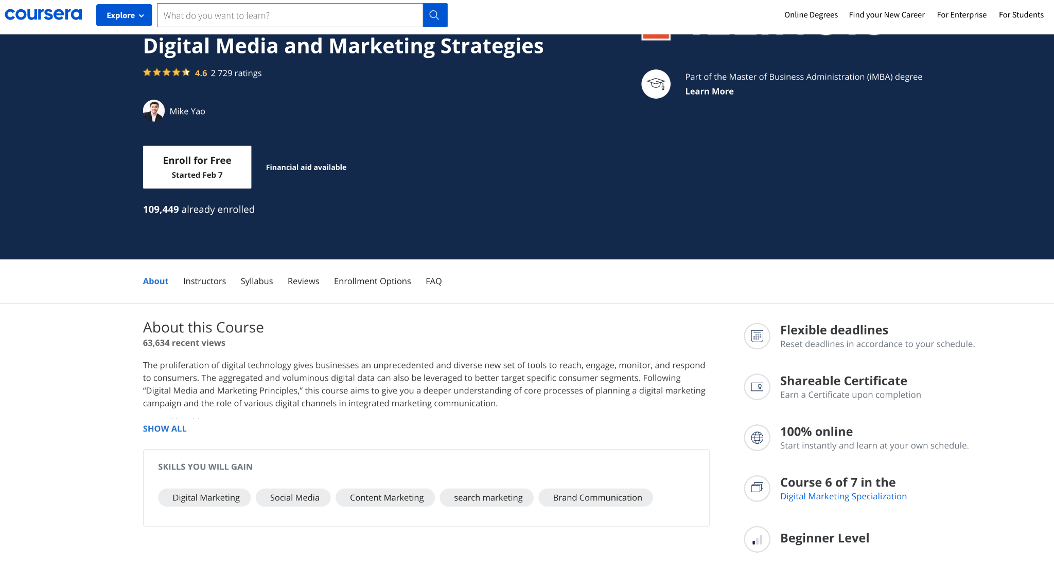
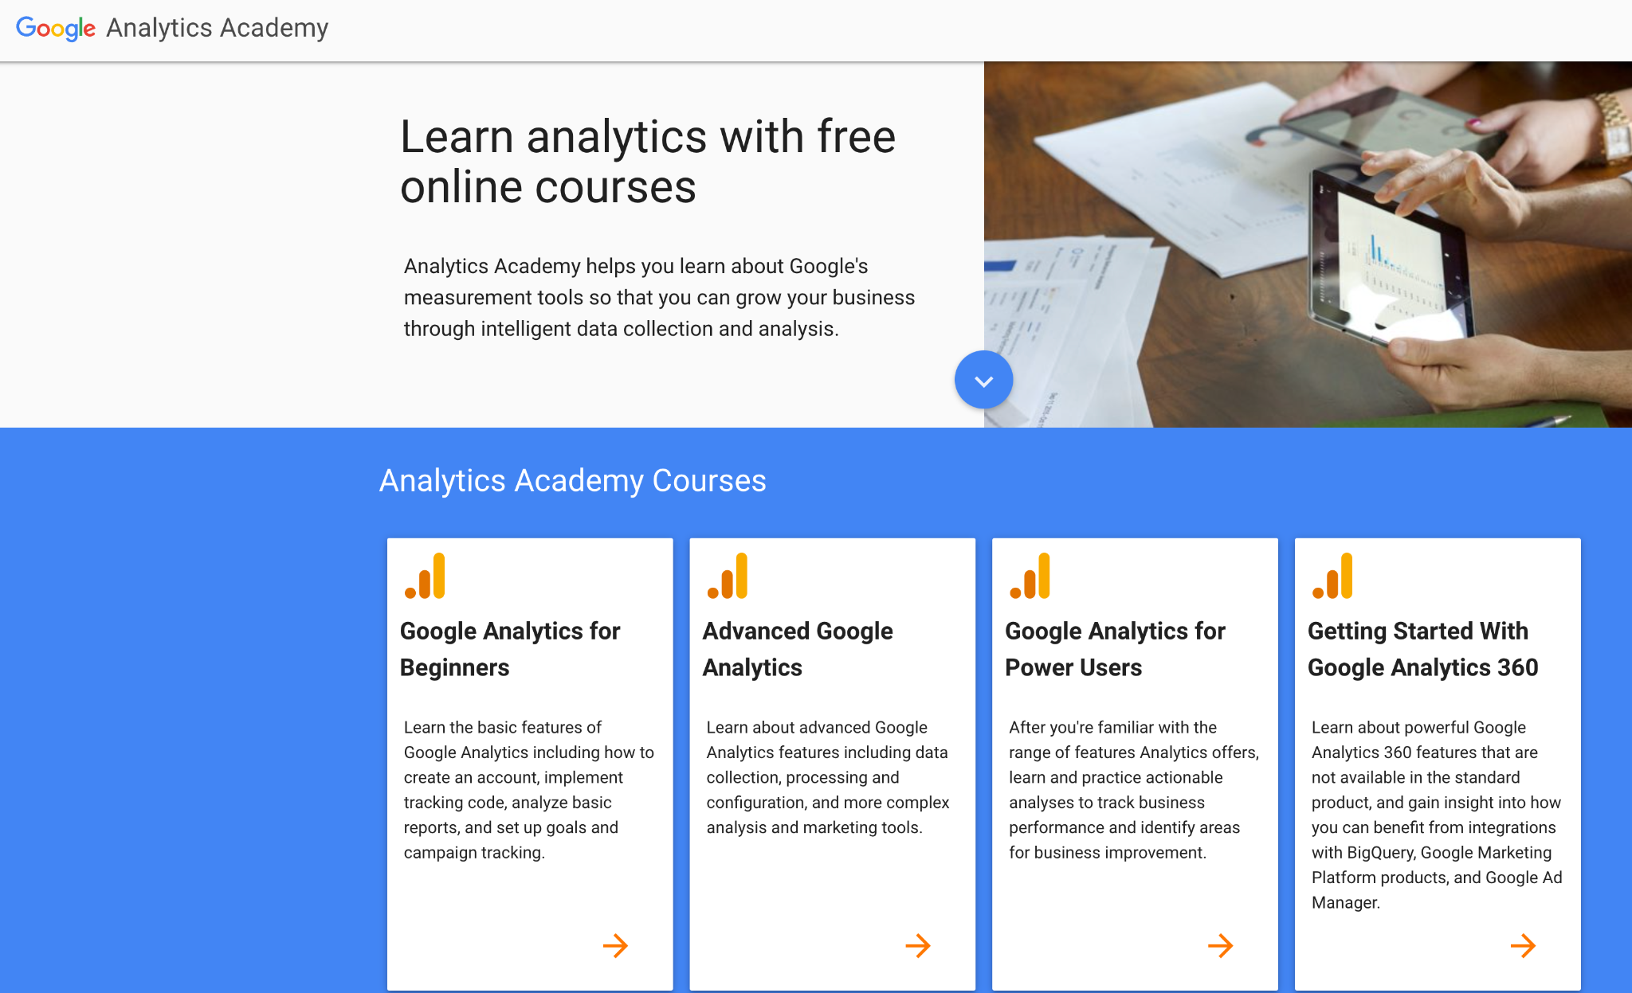
Course “Digital Communications”
Methodology:
Practical Cases
Team Project
Additional Materials
  Free online educational Platforms
    For example, Academy of Google
    Coursera
Final Exam
Tecnocampus, Mataro | February, 2022

Slide 15

Course “Digital Communications”
Evaluation:
Practical Cases:
  Answers to case questions
  Class discussion
Team Project
  Project Report
  Oral Presentation
Additional Materials
  Quiz
Final Exam
  Multiple-choice questions
  Open questions
Tecnocampus, Mataro | February, 2022

Slide 16



Course “Digital Communications”
Learning Outcomes:
Practical Cases:
  information processing and reporting, analytical skills
  Critical thinking
  ability to justify own opinion in public
Team Project:
  Applying theoretical knowledge into the practice
  Entrepreneurial leadership, management skills and reducing risk aversion
  Teamwork, formal reporting skills, formulating and problem-solving real business problems
  Presenting in from of general and professional public (invited company’s representative)
Additional Materials
  enhancing self-esteem and learning on self-actualization skills
Tecnocampus, Mataro | February, 2022

Slide 17
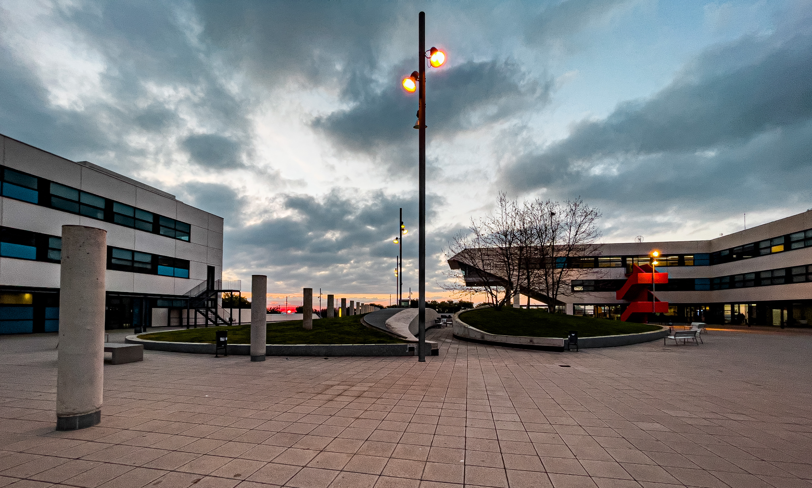
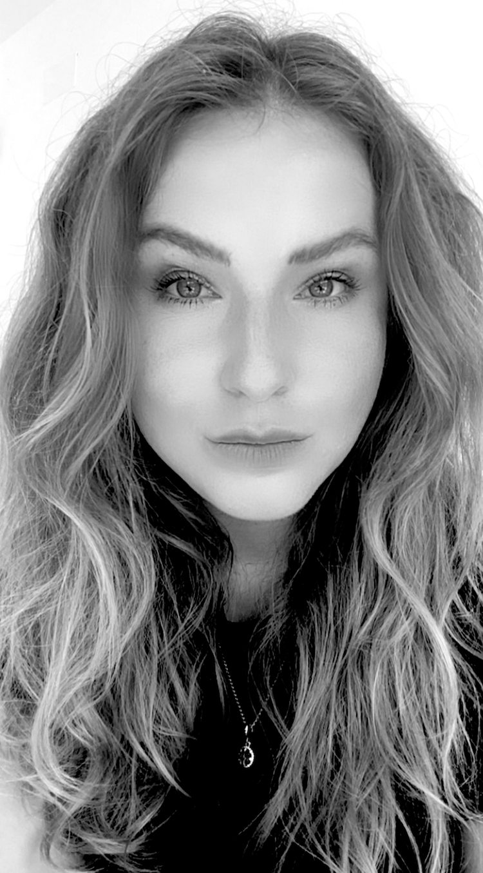
Personal Profile
Currently:
Professor, Researcher, Business Consultant
Languages:
English, Spanish, Russian, Belarusian, Catalan
Personal Traits:
Strong communication skills
Tolerance Optimism and sense of humor
Analytical mindset and critical thinking
Creativity and natural curiosity
Tecnocampus, Mataro | February, 2022

Slide 18
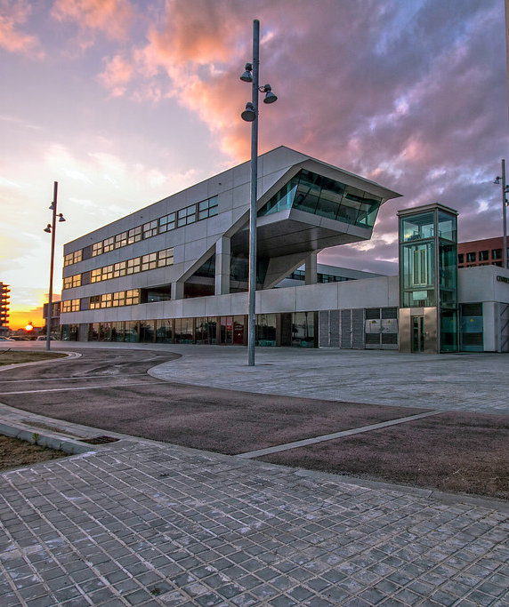


Thank you!
VERA BUTKOUSKAYA, PhD
+34 652 84 55 22 | Barcelona, Spain
✉ vera.butkouskaya@gmail.com
www.verapetrovna.com
Google Scholar View profile
https://orcid.org/0000-0002-6963-3872
https://www.linkedin.com/in/verabutkouskaya/
https://www.researchgate.net/profile/Vera_Butkouskaya
https://publons.com/researcher/3824358/vera-butkouskaya/

